Slide 1
CH- 9 (Differential Equations)
CONTENT
. Order and Degree
. General and Particular Solution
.Formation of Differential Equation
. Solving Differential Equations by Observation
.Variable seperable Differential Eqns
. Homogeneous Differential Eqns
. Linear Differential Eqns

Slide 2
ORDER AND DEGREE

Slide 3
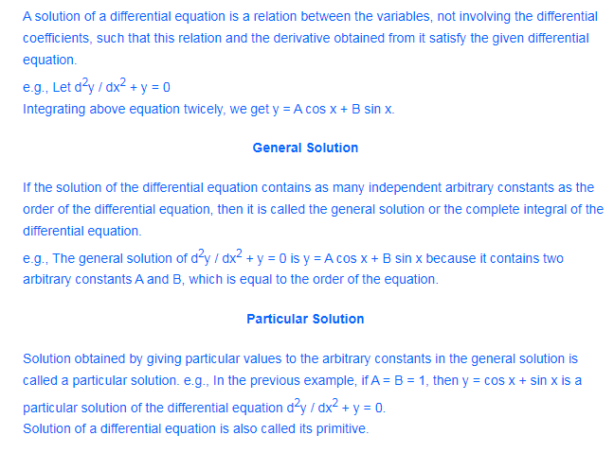
Solution of Differential Equations

Slide 4
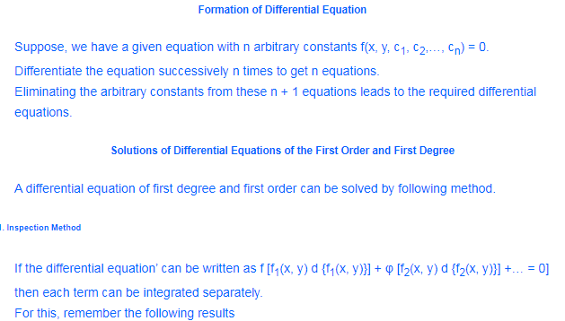
Formation & Solution of Differential Equations

Slide 5
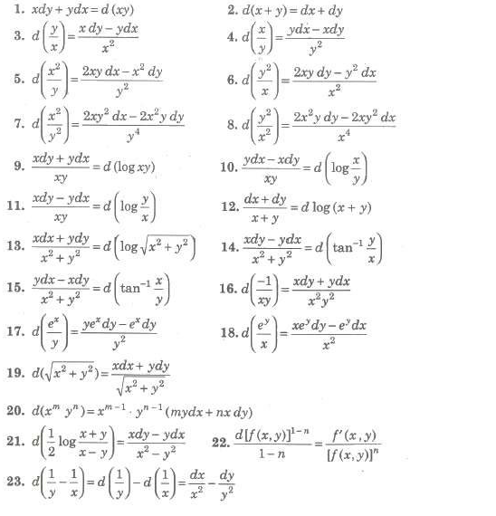
Observation

Slide 6
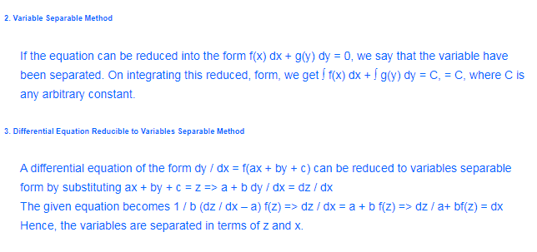
Variable Separable Differential Equations

Slide 7
Homogeneous Differential Equations

Slide 8
Linear Differential Equations

Slide 9
Reference
NCERT TEXT BOOK
NCERT EXAMPLER
SENIOR SECONDARY MATHEMATICS
( DHANPAT RAI PUBLICATIONS )

